Slide 1

Department of Computer Science and Engineering
191CS67A – Mini Project Work – Review
HEALTHCARE CHATBOT FOR RURAL AREA
Guided by,
Mr. PANDI C B.E, M.E(CSE), ASSISTANT PROFESSOR, Dept of CSE.
Team Members:
GOKULAVASAN R – 113121UG03028
RAGAVENDHRA R - 113121UG03079
LOKESH T - 113121UG03057
Batch No: 13
Date : 09/07/2024

Slide 2
OUTLINE OF THE PRESENTATION
Problem Statements
Objective
Abstract
Introduction
Existing System
Proposed System
Architecture Diagram
S/W Requirements
References

Slide 3
Problem Statement
The ever-growing demand for accessible and reliable healthcare information necessitates the development of innovative solutions. Traditional limitations like geographical constraints, language barriers, and information overload hinder individuals from effectively managing their health. Additionally, navigating the complexities of healthcare systems can be time-consuming and frustrating.We propose a Python-based healthcare chatbot to bridge these gaps and empower users to take charge of their well-being.
This chatbot will address the following challenges:
Limited Access to Reliable Information
Language Barriers
Information Overload
Inefficient Communication Channels

Slide 4
Objective
Develop a Python-based healthcare chatbot that enhances accessibility and comprehension of medical information for users, while promoting self-care practices and reducing strain on healthcare systems.

Slide 5
Abstract
This paper proposes a Python-based healthcare chatbot designed to address limitations in healthcare information access. The chatbot targets challenges like geographical constraints, language barriers, and information overload, empowering users to manage their health more effectively. It provides 24/7 access to trustworthy health information, multilingual support, a user-friendly interface, and triaging with self-care guidance. This project aims to improve healthcare access, user empowerment, and reduce the burden on healthcare systems.

Slide 6
Introduction
The ever-increasing demand for accessible and reliable health information necessitates innovative solutions. Traditional limitations like geographic constraints, language barriers, and information overload hinder individuals from effectively managing their health.
Complex healthcare systems further complicate the process, often requiring appointments and phone calls, creating time constraints and accessibility issues. This paper proposes a Python-based healthcare chatbot to bridge these gaps and empower users to take charge of their well-being.
This chatbot will address these challenges by providing:
24/7 access to trustworthy health information curated from credible medical sources.
Multilingual support to ensure users receive critical health information regardless of their native language.
A user-friendly interface for real-time health inquiries through text or voice input.
Triaging and self-care guidance to direct users towards appropriate self-care measures or recommend seeking professional help when necessary.
By addressing these challenges, the healthcare chatbot has the potential to revolutionize healthcare access. It can empower individuals to make informed decisions about their health, promote early detection and prevention of illnesses, and ultimately reduce the burden on healthcare systems.

Slide 7
Existing System
Limited functionality: Many healthcare chatbots lack the ability to handle complex medical inquiries or provide nuanced guidance.
Accuracy concerns: The accuracy of information provided by chatbots can vary depending on their programming and data sources.
Lack of empathy: Chatbots cannot replicate the human empathy and emotional intelligence of medical professionals.
Privacy issues: Data security and privacy are important considerations when using healthcare chatbots.

Slide 8
Proposed system
Enhanced AI and Machine Learning: By incorporating advanced AI and machine learning algorithms, chatbots can offer more sophisticated functionalities like handling complex medical queries, understanding natural language, and providing more tailored guidance.
Integration with Electronic Health Records (EHR): Linking chatbots with EHR systems would enable them to access a user's medical history, providing more personalized health information and recommendations.
Human-in-the-Loop Design: A hybrid approach combining chatbots with human oversight from medical professionals can address limitations and build trust. For instance, chatbots can handle routine inquiries, while complex issues can be escalated to healthcare providers.
Focus on Empathy and Emotional Intelligence: While emotions are a challenge for AI, chatbots can be programmed to use more empathetic language and offer support resources to users.

Slide 9
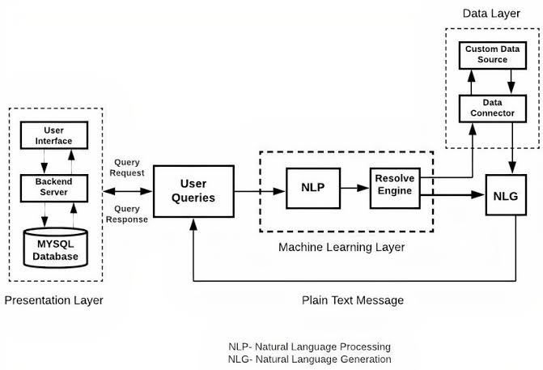
Architecture Diagram

Slide 10
SW Requirements
Python (programming language)
NLTK / spaCy (NLP library)
TensorFlow / PyTorch (machine learning library - optional)
PostgreSQL / MySQL (database)

Slide 11
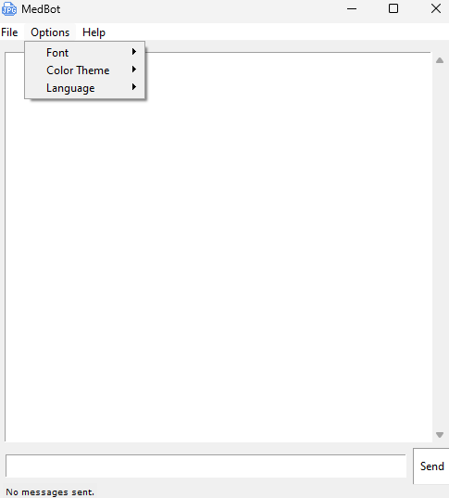

Slide 12
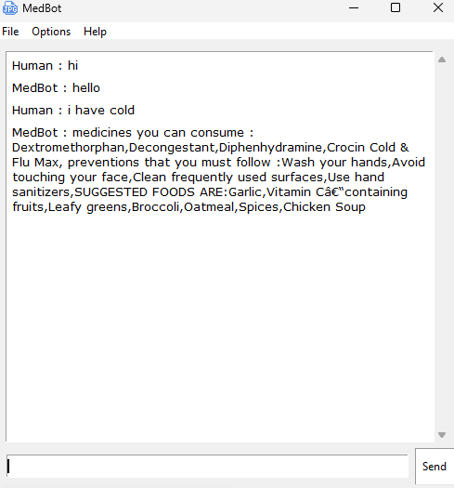

Slide 13
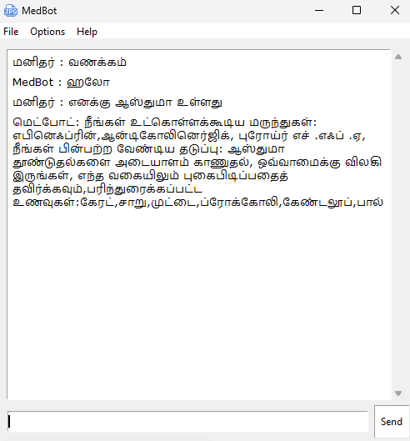

Slide 14
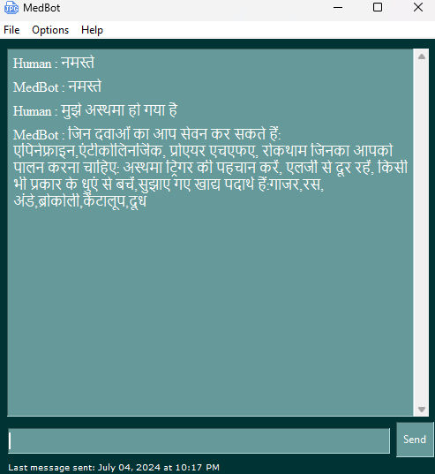

Slide 15
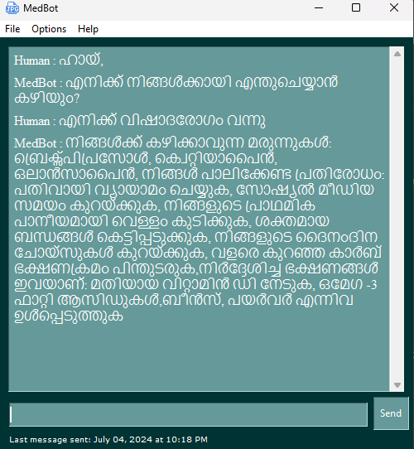

Slide 16
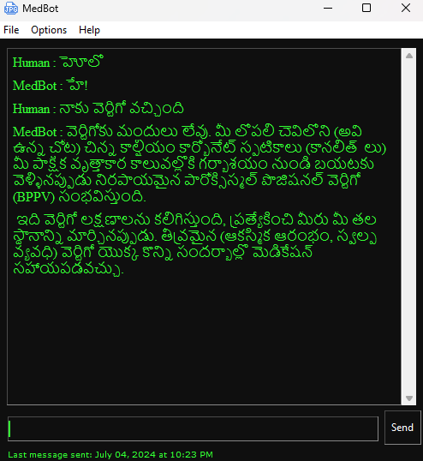

Slide 17
References
[1] R Jegadeesan, Dava Srinivas, N Umapathi, G Karthick, N Venkateswaran, “PERSONAL HEALTHCARE CHATBOT FOR MEDICAL SUGGESTIONS USING ARTIFICIAL INTELLIGENCE AND MACHINE LEARNING”, Jyothishmathi Institute of Technology and Science, Karimnagar, Telangana. Eur. Chem. Bull. 12 (S3), 6004 – 6012. 13 March 2023
[2] T. Padmavathy, K. Rajarajeshwari, J. Kavvya, M. Reni, “A Survey on Healthcare Chatbot Using Machine Learning”, International Journal of Innovative Research in Engineering & Management (IJIREM) ISSN: 2350-0557, Volume-7, Issue-2, March 2020
[3] LekhaAthota, Vinod Kumar Shukla, Nitin Pandey, Ajay Rana, “Chatbot for Healthcare System Using Artificial Intelligence”, International Conference on Reliability, Infocom Technologies and Optimization (Trends and Future Directions) (ICRITO) Amity University, Noida, India. June 4-5, 2020.
[4] Duckki Lee,“ AI-based Healthcare Chatbot”, International Research Journal of Engineering and Technology (IRJET), Yonam Institute of Technology in South Korea, Feb 2023.
[5] Mark Lawrence, MD Istiyak, Mohd Aman, “HEALTHCARE CHATBOT SYSTEM”, International
Journal of Novel Research and Development, © 2024 IJNRD | Volume 9, Issue 3 March 2024|
ISSN: 2456-4184

Slide 18
THANK YOU

